Slide 1
Adapter Pattern

Slide 2
Introduction To Design Patterns
Design Pattern is the general reusable solution to a commonly occurring problem in software designing.
It is required as it will help in making code more reusable and loose coupling.

Slide 3
Adapter Pattern
An "off the shelf" component offers compelling functionality that you would like to reuse, but its "view of the world" is not compatible with the philosophy and architecture of the system currently being developed.
The Adapter pattern converts the interface of a class into another interface the client expect. Adapter let classes work together that couldn’t otherwise because of incompatible interfaces.
Any change in the code of interface will only propagate changes in the adapter implementation, not in the client code. This will ensure loose coupling.

Slide 4
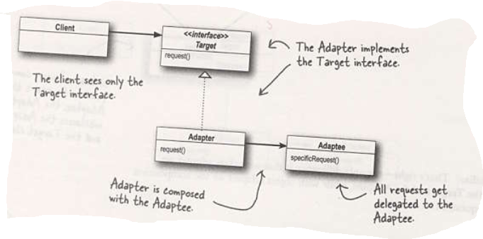

Slide 5
Here the client is using Target interface, the advantage of having it as an interface is we can have multiple adapter implementing this interface.
Adapter will delegate the request to the adaptee and will return the value returned by adaptee.
The advantage of having adaptee as interface is we can have multiple implementation of it.

Slide 6
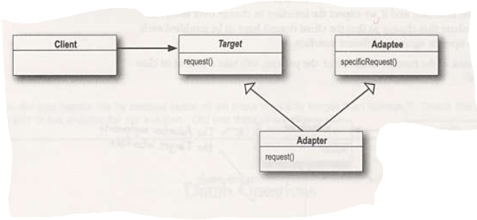
Class Adapter

Slide 7
Real Life Example
Iterator are introduced in Java after Enumeration, hence there are many legacy code which will provide Enumeration as return type, but as coding standard new code should use Iterator. Hence, Adapter pattern can be used here which plugs the implementation of the enumeration and exposes an Iterator.

Slide 8
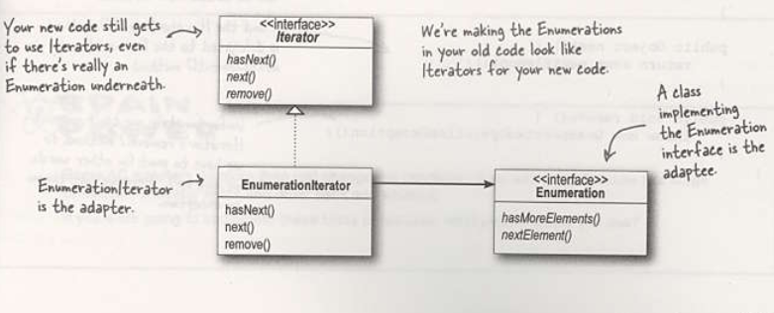

Slide 9
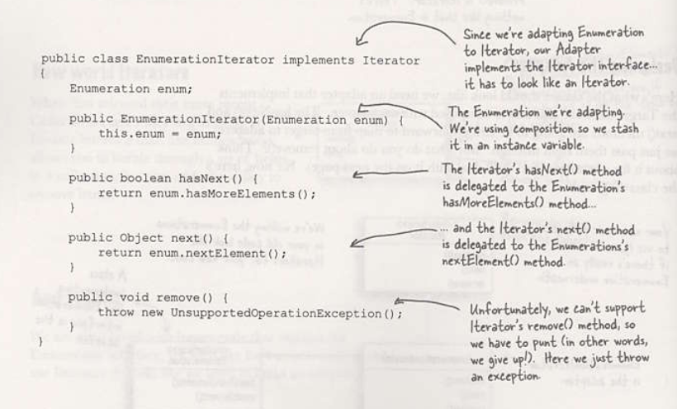

Slide 10
Thank You

